Slide 1


Project 9: IoT Based Load Management System -Team 9

Slide 2
Problem At Hand
Power generation from solar panels is variable due to variations in solar irradiance, temperature and other components. Often when a system is entirely based on solar powering, it tends to compromise on the regularity and availability of power.
Conventional energy sources guarantee 24/7 availability of power but are limited on a long term basis and come at the cost of serious environmental damages.
What the current situation demands is striking the right balance between the two or in other words maximize the use of solar energy and minimize that of conventional while ensuring uninterrupted power supply.
The aim of the project is to design an intelligent IoT based system that efficiently switches between Solar and Conventional Energy based on the load requirements of the user while ensuring a regular power supply.

Slide 3
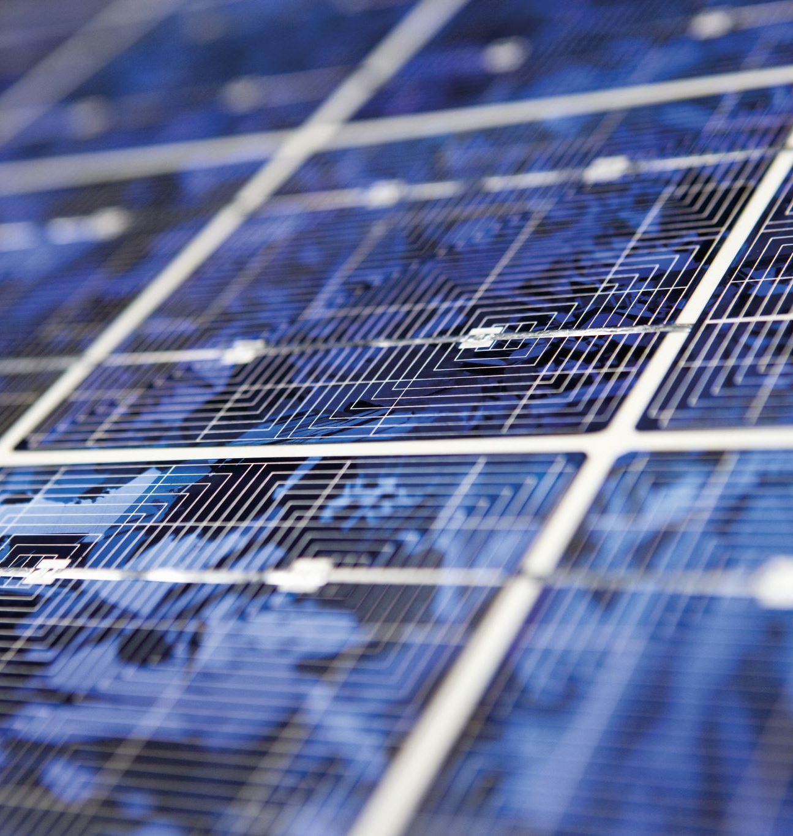


Motivation
Suppose we have eco-system with 3 units namely a hospital, a shop and a factory.
It is naturally expected that the hospital should never face a power failure but at the same time we want to power all the units with solar energy as much as possible.

Slide 4
Our Pitch
Usually at 11-12pm the midday sun is at its highest intensity. Hence, we will power all 3 units with solar power while conventional is driven to 0.
Around 4-5 pm in the afternoon, the Sun starts to set hence the solar current decreases and it is likely that it will not be able to power all 3 units. Since we need to maximize solar and minimize conventional, we switch to a combination of solar and conventional to power the system.
During the evening around 6-7pm the solar energy is negligible. To minimize conventional we need not power the factory ,thus we shall power the other 2 units using conventional current and available solar power.
At night, it is optimal to only power the hospital as it is our priority for which we will use conventional.
Without IoT, we would need to hire someone to connect and disconnect the respective circuits. However using the knowledge and resources IoT has, we have created an automatic switching system that relays between Solar and Conventional depending on load requirements.

Slide 5
Project Features
Automatic switching between Solar and Conventional depending on load requirements.
User Interface-based notifications of abnormal energy consumption.
User interface-based readings of power outages and consumption.
Predictive analysis of energy usage patterns based on user behavior.
Visualization and analysis of energy usage patterns through various graphs for different scenarios.
Real-time monitoring and control of energy consumption of various devices and appliances.
Priority-wise supply of power in various buildings, for example, a hospital would be on top priority while deciding distribution and mode of power supply.

Slide 6

HARDWARE components
Current Sensors
LDRs
Relays
Motors
Solar Panels
Breadboard
Wires
ESP-32
USB Cables
Resistors

Slide 7

SOFTWARE TOOLS
Arduino IDE
Python
HTML,JS,CSS
OM2M
ThingSpeak
Postman
Jupyter Notebook

Slide 8
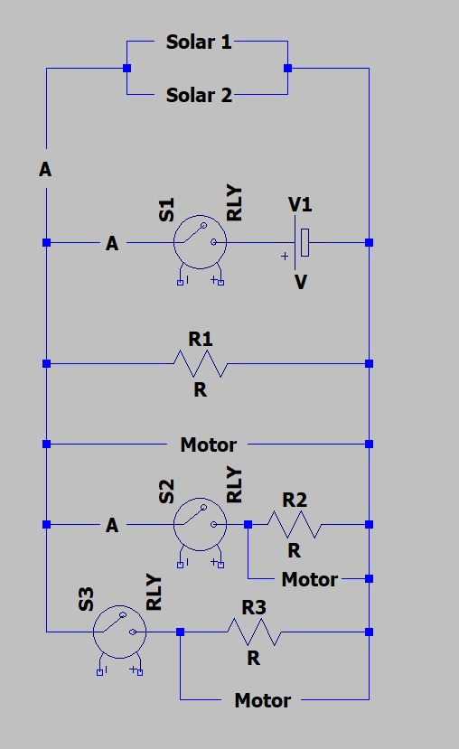
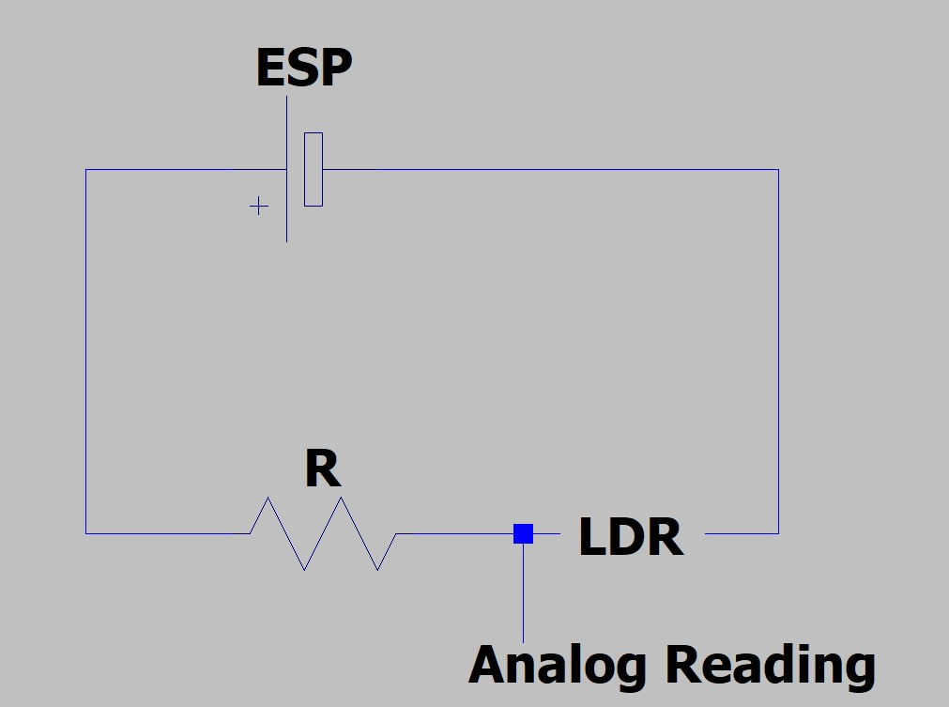
Hardware Diagram

Slide 9
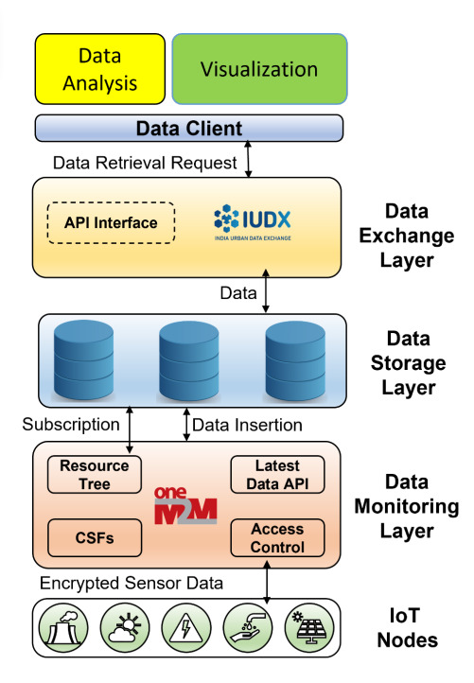
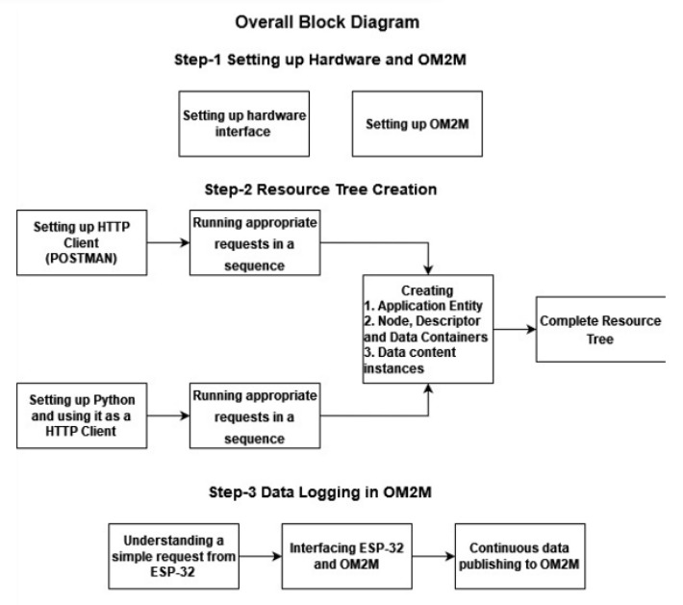
References for software

Slide 10
Software diagram
Overall IoT Infrastructure
APPLICATION AND BUSINESS LAYER
User Interface
Protocol used: HTTP
MIDDLEWARE LAYER
ESP32
NETWORK LAYER
Wifi, 5G
PERCEPTION LAYER
Current Sensor, LDR,Solar Panel

Slide 11
ThingSpeak
Decision Making Unit
ESP32
Relay
(Actuator)
SENSOR DATA
Python
POST
Data Analysis
Graphs, Predictions and other data driven features on UI
GET
OM2M
Data Visualization
GET
GET
Predictive Analysis Model

Slide 12
Flow of the project
Measure the intensity of sunlight available through LDR. This gives us the idea of how much load solar power can support.
Measure the load requirement through the current sensors deployed in every load. Also measure how much current the solar panels can provide.
These values captured by the microcontroller are sent for information processing and logical decision making.
Based on the solar and conventional readings and load requirements, we make power supply decisions to all our loads in favor of minimizing conventional and maximizing solar.
For example:
Case 1: Solar power is very low (Night time)
Only priority 1 that is hospital is powered
Case 2: Solar is considerably low (Evening time)
Priority 1 and 2 are powered using a combination of both. This involves automatic optimization to maximize solar power.
Case 3: Solar is considerably high (Afternoon time)
All the loads are powered using only solar energy

Slide 13
Flow of the project(continued)
The switching is done by an automated switching system consisting mainly of relay modules as an actuator.
The same sensor data collected in the physical layer is sent to ThingSpeak for Real Time Monitoring and OM2M for future analysis, Data visualization, Prediction requirements and data storage.
Once the data is on cloud, our job is to retrieve the data and use it for productive analysis. So we retrieve the data from OM2M using Python.
Using the data retrieved, we plot graphs to visualize and analyse the data.
The same data serves as input for the notification system in our User Interface that keeps the user updated with status of all the loads and warns against abrupt energy fluctuations.
The data is also used in our predictive analysis model which predicts the optimal energy layout for load scenarios desired by the user.

Slide 14
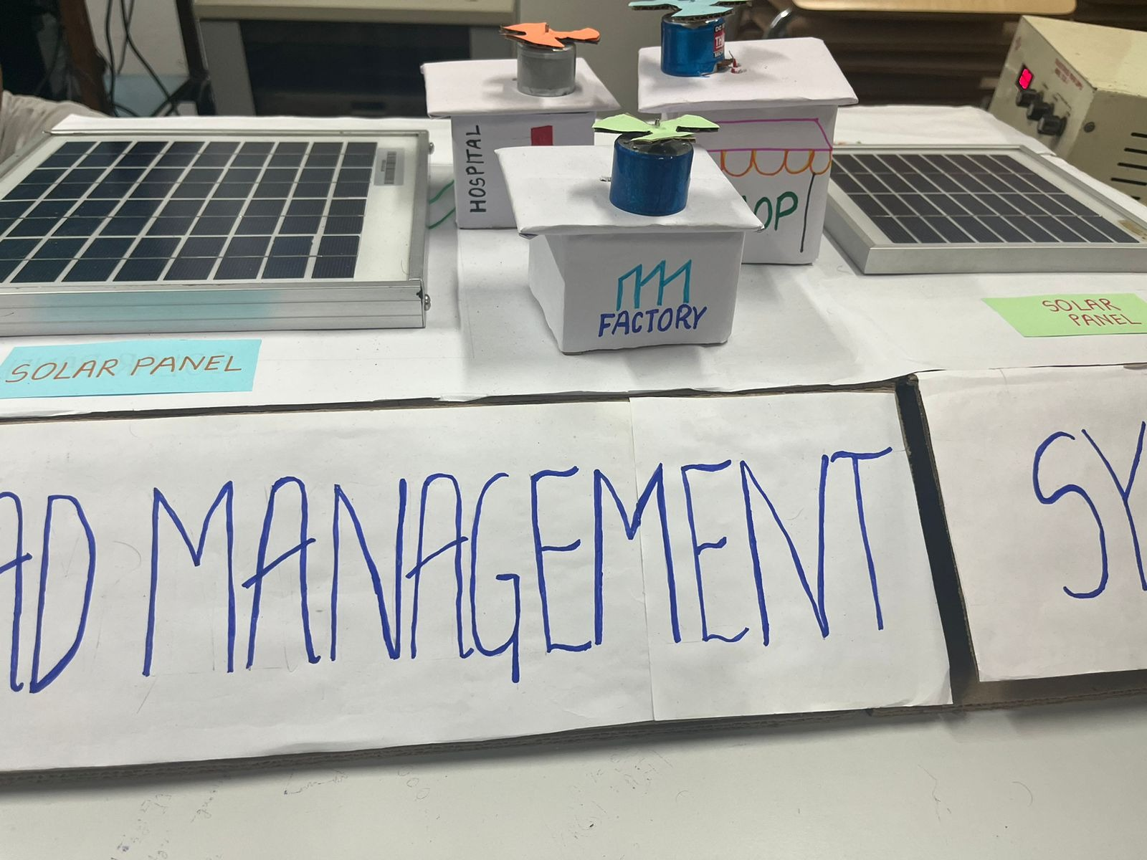
TABLE TOP

Slide 15
Data collection
The dataset has been constructed from data collected over a span of 10 days that gave us around 750 data points.
To diversify the dataset, we have collected data in different time intervals of the day to simulate all possible scenarios.
Data collection was done in Amphitheatre near Bakul hostel ..

Slide 16
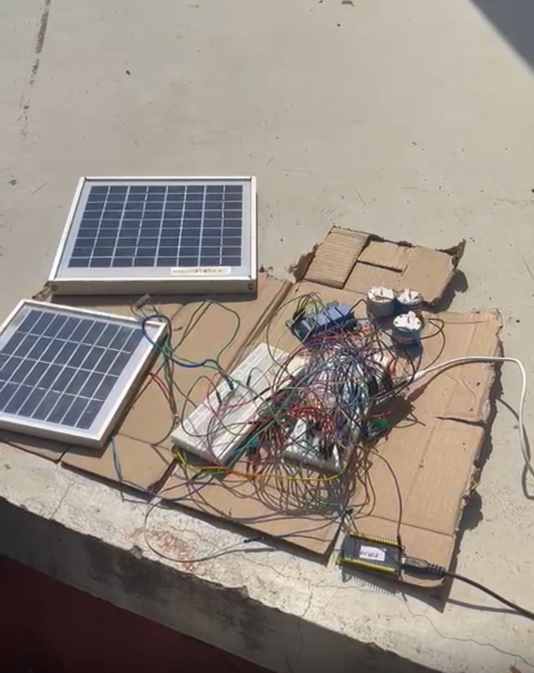

Slide 17
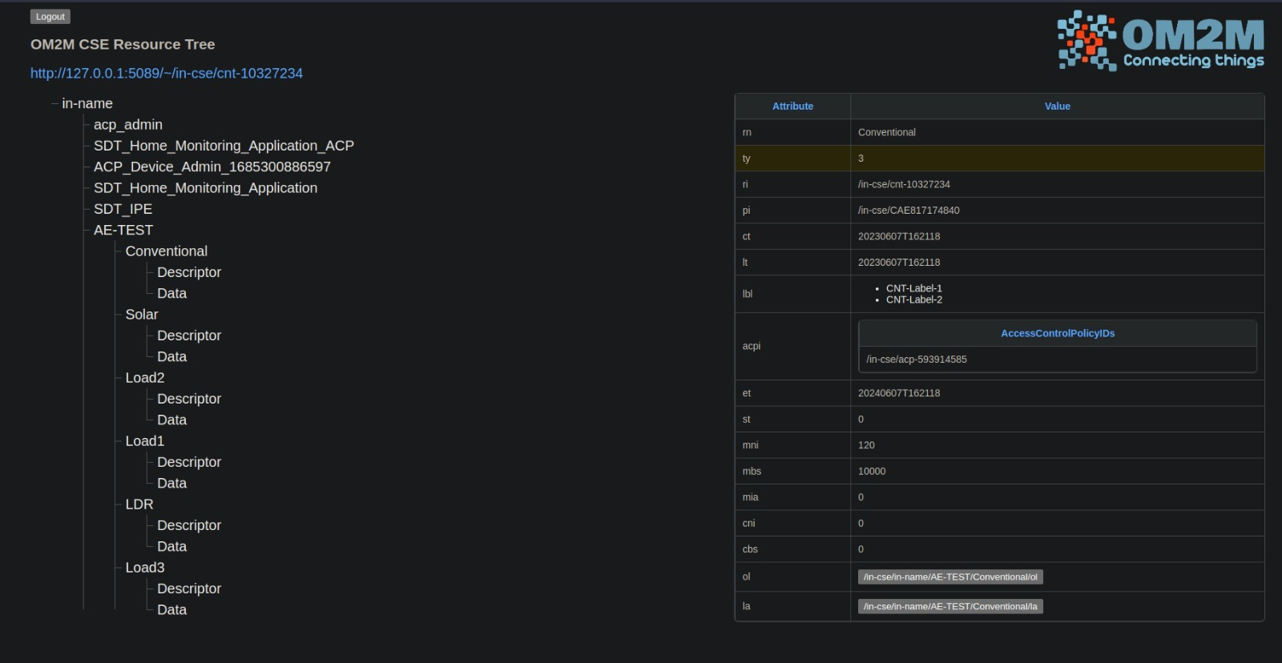
Om2m data storage

Slide 18
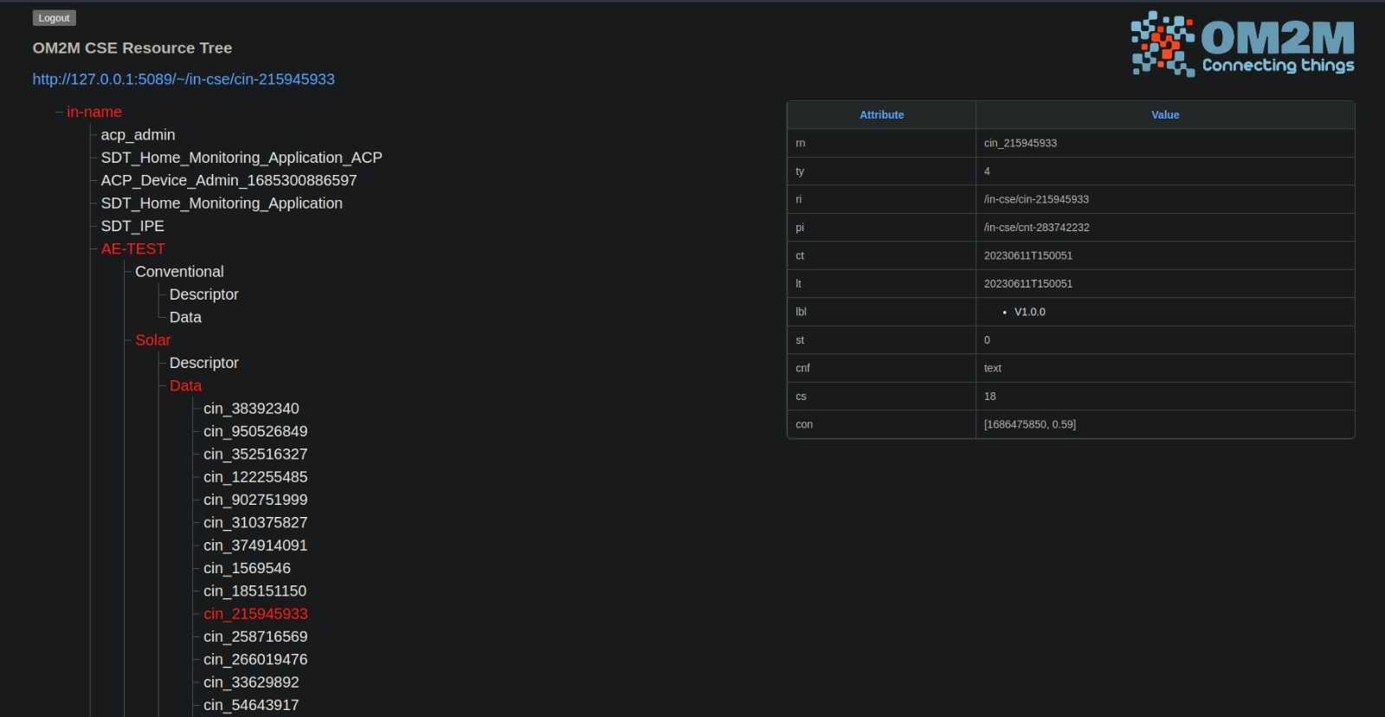

Slide 19

DATA VISUALIZATION

Slide 20
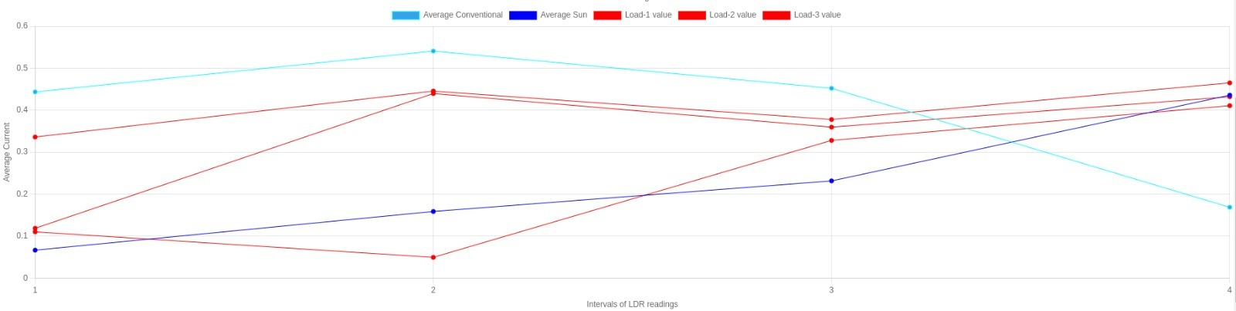

Slide 21
Analysis
This is graph of average current generated by the solar, conventional and average current consumed by the loads vs (Testcases) LDR intervals .
The 1st test case is 0-2000 LDR reading . During this the solar supplies very less energy , conventional is the main source which drives the circuit and only one of the loads i.e Load1 works, all other loads 2,3 are next to zero . There is some error in value because of some random noises and current sensor failures that might have been encountered..
The 2nd test case is 2000-2500 LDR reading. In this interval there is some solar energy . Solar + conventional is used to drive Load1 and Load2 . The average current used by Load3 is 0 as Load3 is not supplied any power . The two Loads 1 and 2 consume on an average similar power . This is because there resistance is very similar .. And from the graph we can see that current supplied to load1 does not change and is somewhat constant ..
The 3rd test case is 2500-3000 LDR reading. In this interval there is an increased solar energy as depicted in the average . Solar + conventional is used to drive all the 3 loads . The three Loads 1,2 and 3 consume on an average similar power . This is because there resistance is very similar .. And from the graph we can see that current supplied to loads does not change much and is somewhat constant .. Solar energy in this light level is not enough to support all the 3 loads that why conventional energy is used to drive the circuit ..
The 4th test case is 3000+ LDR reading. In this interval solar energy is able to generate enough current to power all the 3 loads . The three Loads 1,2 and 3 consume on an average similar power . This is because there resistance is very similar .And from the graph we can see that current supplied to loads does not change much and is somewhat constant .The conventional source of energy is not needed and is close to 0 . Some average current is there because of some current sensor error or noise which may have been recorded while data collection and testing …

Slide 22
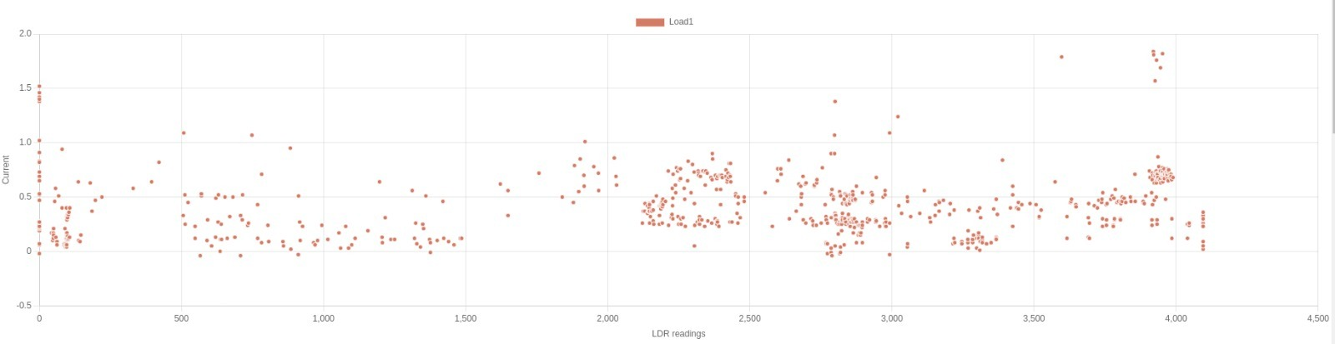

Slide 23
analysis
For load 1 we can infer from the graph that the graph is remaining constant with the light level (LDR Reading) . Theoretically this is the case because at any part of the day current is being supplied to the load with the help of solar panel or conventional source because this is of highest priority (Hospital)… In the scatter plot we can also see that some of the readings are not accurate . This is because of current sensor error or some noises which interfered during testing and data collection..

Slide 24
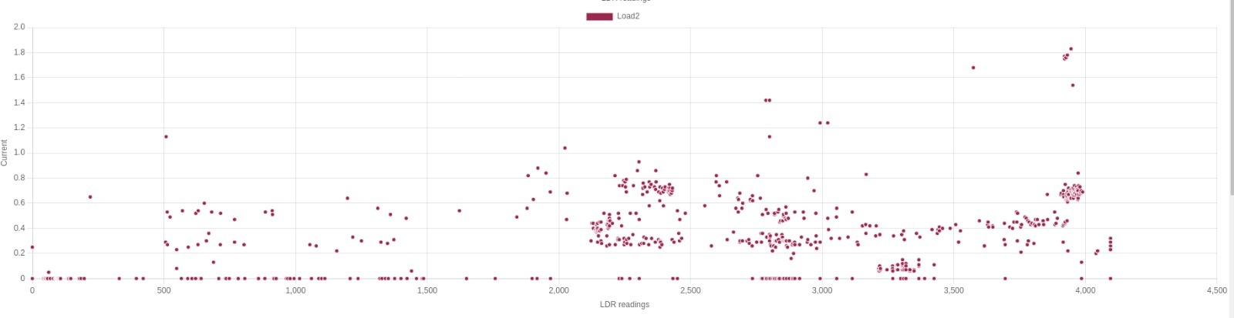

Slide 25
Analysis
For load 2 we can infer that the during the light level(LDR Reading) 0-2000 the graph has most of the readings 0 or no current during this interval and after that interval the current through the load starts to increase . Theoretically this should be the case because at light level of 0-2000 ,the light level in this range correspond to night and at night to optimise energy consumption the shop should not the powered as the shop is closed during that time . And at the light level 2000+ this corresponds to evening and broad daylight during which the shop is operational and should be powered which is the case .. In the scatter plot we can also see that some of the readings are not accurate . This is because of current sensor error or some noises which interfered during testing and data collection

Slide 26
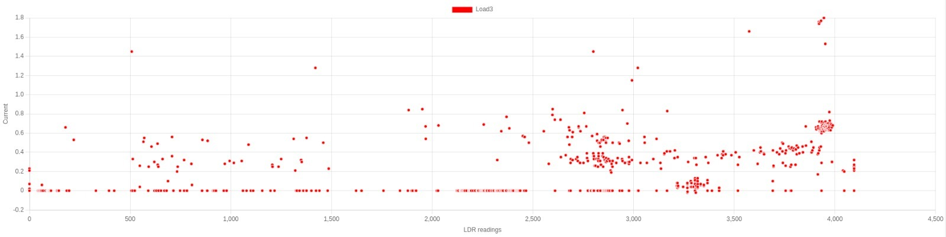

Slide 27
Analysis
For load 3 we can infer from the graph that during the light level(LDR Reading) 0-2500 the graph has majority of the readings 0 after that there is a sudden increase in the current that goes through the load . Theoretically this should be the expected output as in the light level 0-2000 , the light level corresponds to the night and at night the factory should not be powered. Also the light level of 2000-2500 , light level corresponds to the evening and at that generally or in our case the factory is closed .. At the light level 2500+ this corresponds to broad daylight and at that time factory is operational so it consumes current .. In the scatter plot there is some irregularities in the data . This is because of failure in current sensors or some noises which may interfere when testing and data collection was conducted

Slide 28
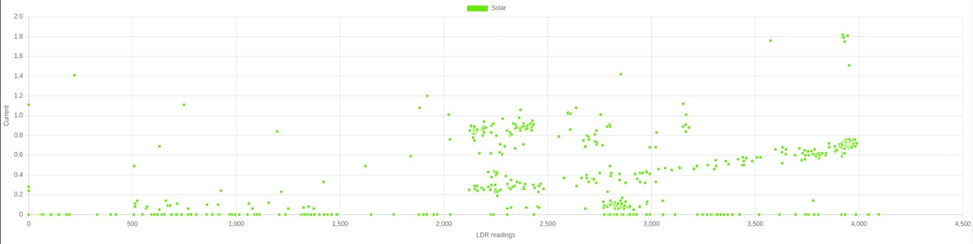

Slide 29
Analysis
From the graph of solar energy vs Light Level(LDR Reading) we can see that when Light level is between 0 and 2000 most of the energy that solar panel supplies is next to 0 and when the light level reaches a certain value the solar panels starts to supply current and as the light level increases the current through the solar panel increases linearly with the light level . Theoretically this is the case because the light level 0-2000 corresponds to night during which no solar energy can be generated and light level 2000-2500 corresponds to evening during which less current is generated but as the light level becomes 2500+ the light level corresponds to broad daylight during which very large amount of current is generated by the solar panels..In the scatter plot there is some irregularities in the data . This is because of failure in current sensors or some noises which may interfere when testing and data collection was conducted .

Slide 30
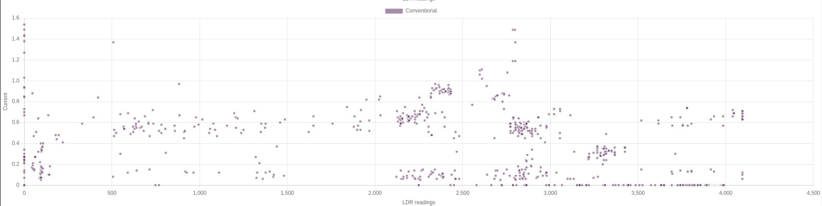

Slide 31
Analysis
From the graph of Conventional vs Light Level(LDR Reading) we can infer that when the Light Level is between 0 and 2000 conventional source provides most of the current and as the Light level increases the current through conventional source starts to decrease and at light reading 3000+ current from conventional source is next to 0. Theoretically this is the case because the interval 0-2000 of light reading ,corresponds to night and at that conventional source is used to drive the priority 1 (Hospital) . During the interval of 2000-2500 , Light level corresponds to evening and at that solar + conventional is used to drive the loads and since there is some solar energy the energy that conventional provides is decreasing linearly . This is also the case for 2500-3000 interval as at this interval solar + conventional is used to drive all 3 loads. We need very little amount of conventional source as solar energy is very close to being sufficient to drive all the 3 loads ..In the scatter there are some random data points which is due to current sensor failure,esp-32 giving variable outputs and due to random noises which may be generated while data collection .

Slide 32
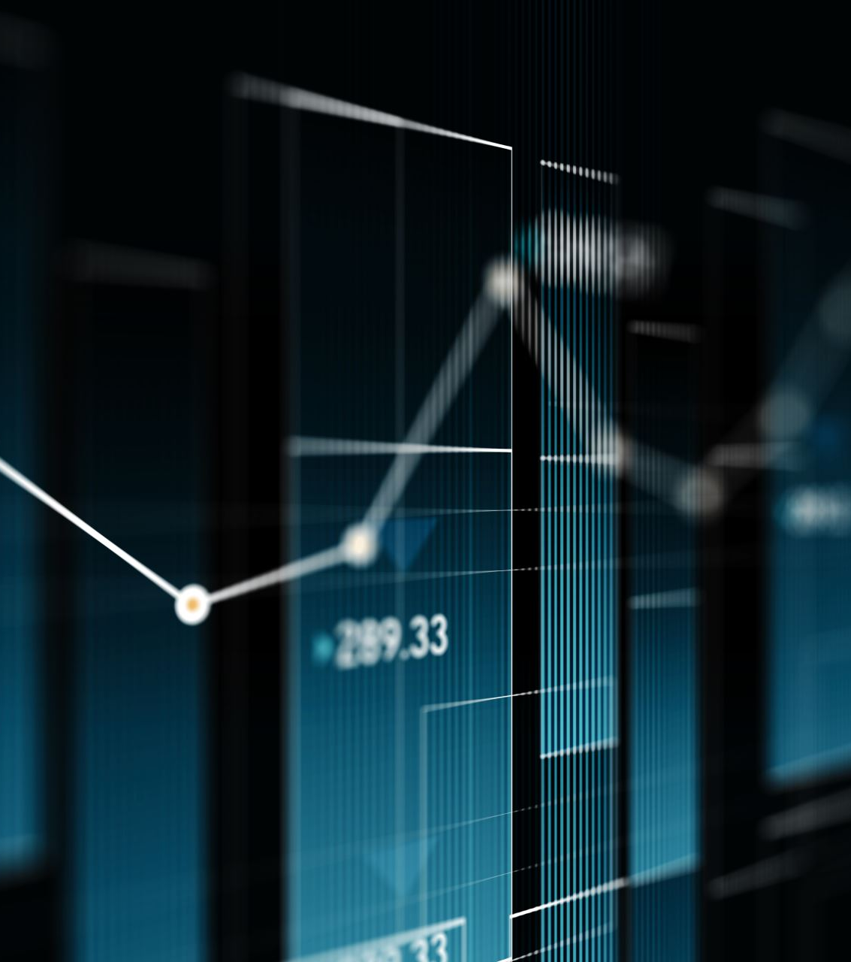
Predictive analysis
The data obtained from OM2M is split into train and test data set and then the best fitting polynomial curve of degree 3 is found for the train dataset.
The model is tested against the test dataset and the error is minimized by varying the degree.
The dependent variable here is the Light Intensity and Independent variables are the load requirements of the three loads.
This allows us to predict the Sunlight and Convention power requirements of any given data (Load1, Load2, Load3) using the regression model obtained from the train dataset.
By leveraging polynomial regression in IoT based management system, it becomes possible to make informed decisions about electricity usage, optimized resource allocation and enhance energy efficiency based on historical data patterns.

Slide 33

Failure analysis
Sensor Failure Sensors
If the sensors are not calibrated correctly, they may produce incorrect voltage measurements, leading to inaccurate decisions regarding power source switching.
Wear and tear of LDR. This can lead to inaccurate light measurements, affecting the system's ability to accurately assess solar irradiation levels
Relay Failure
Wear and tear, which can cause a variety of issues like contact degradation .
Relay Coil failure is also another potential error, leading to improper power distribution and potential imbalances in load prioritization.
Communication Errors
Latency
Transmission Malfunction
Environmental Factors
Overheating
Exposure to Dust
Humidity

Slide 34
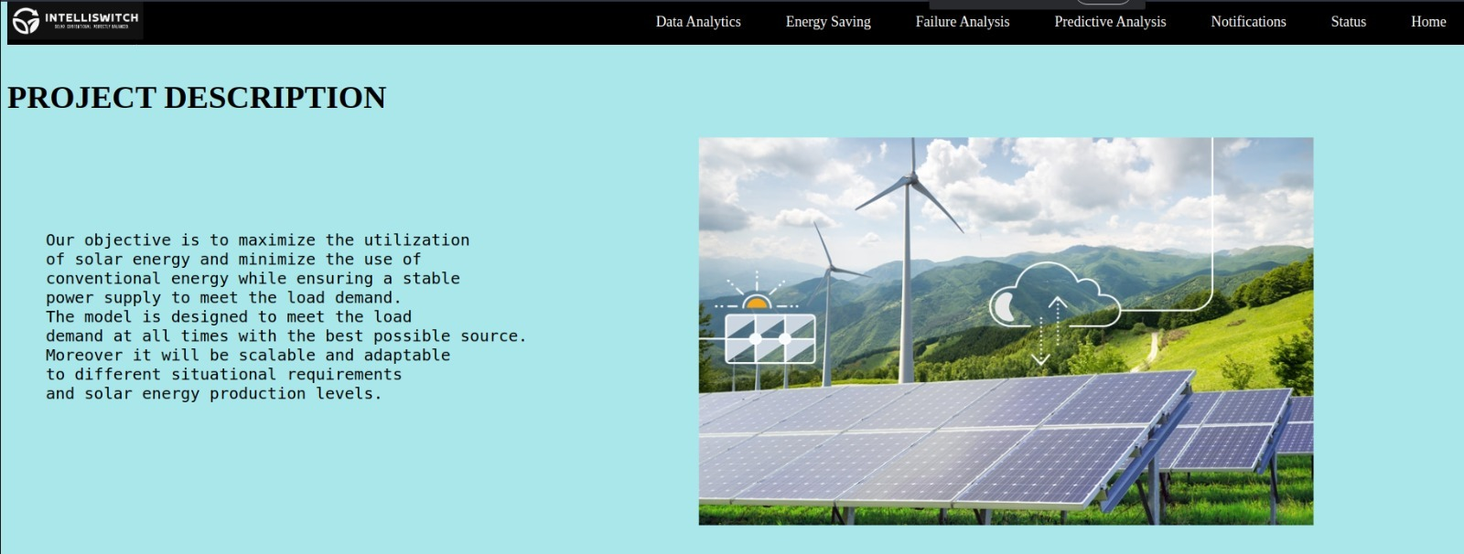
User interface

Slide 35
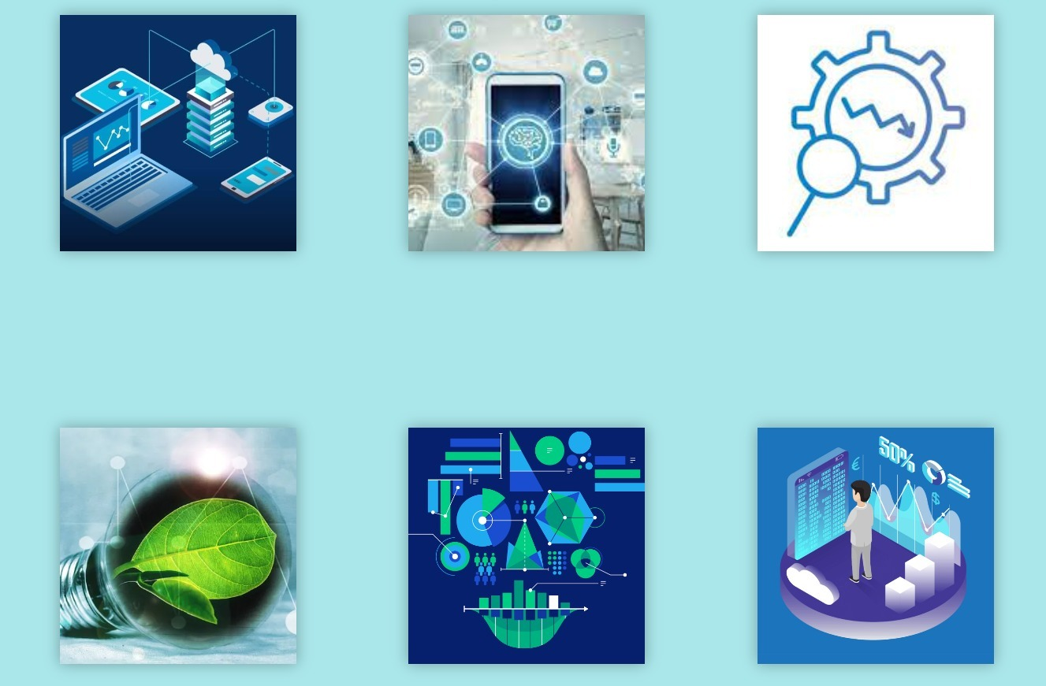
OUR SERVICES

Slide 36
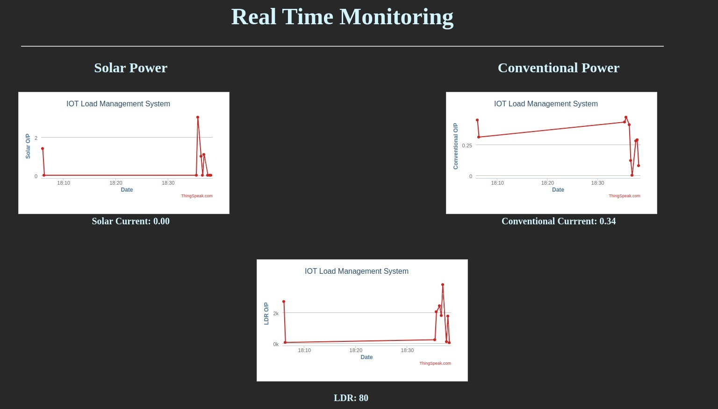

Slide 37
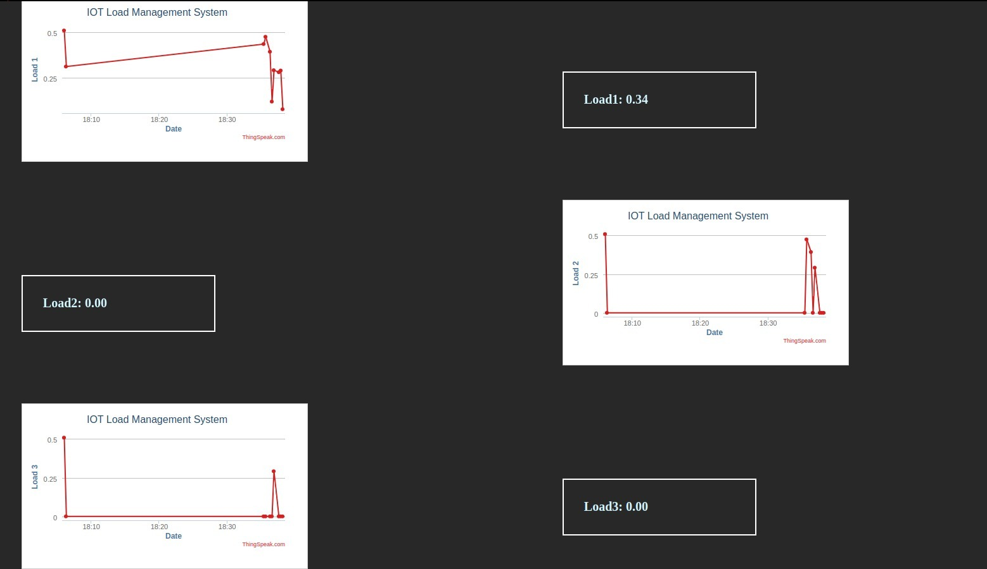

Slide 38
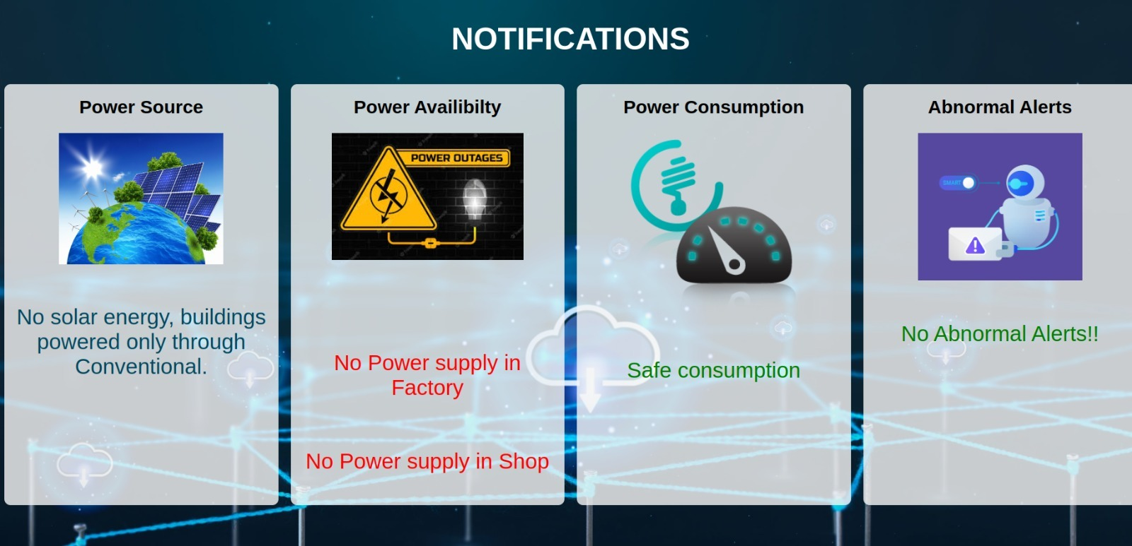

Slide 39
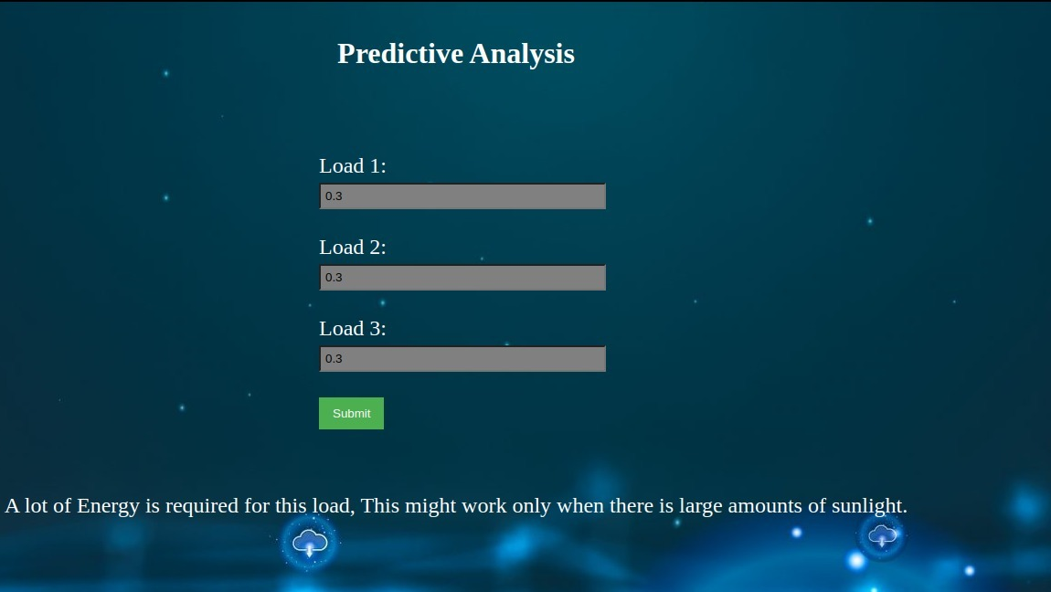

Slide 40

Team members and contribution
Aditya Garg :- Thingspeak , UI for Thingspeak,Hardware.
Alex Thuruthel:- Hardware , Energy saving page ,Failure Page.
Archisha Panda:- UI, LDR,OM2M, Table Top,Data visualization.
Anish Joishy:- Current sensors, Hardware, Table top, Predictive analysis, UI, Circuit Coding,Data collection.
Chirag Dhamija:- Thingspeak, Energy saving page ,Failure Page.
Divya Prakash :- Hardware, Table Top, Logisitical Support.
Jagankrishna Nallasingu:- Hardware, Thinsgpeak.
Konireddy Varshitha :- LDR,OM2M, Table Top.
Sanchit Jalan:- Hardware,OM2M,Data analysis, Table top, Circuit Coding, UI, Data collection.
Vyakhya Gupta:- UI, Table Top, Data visualization, OM2M, LDR.

